Slide 1
Relative Readmission Risk Monitor

Slide 2
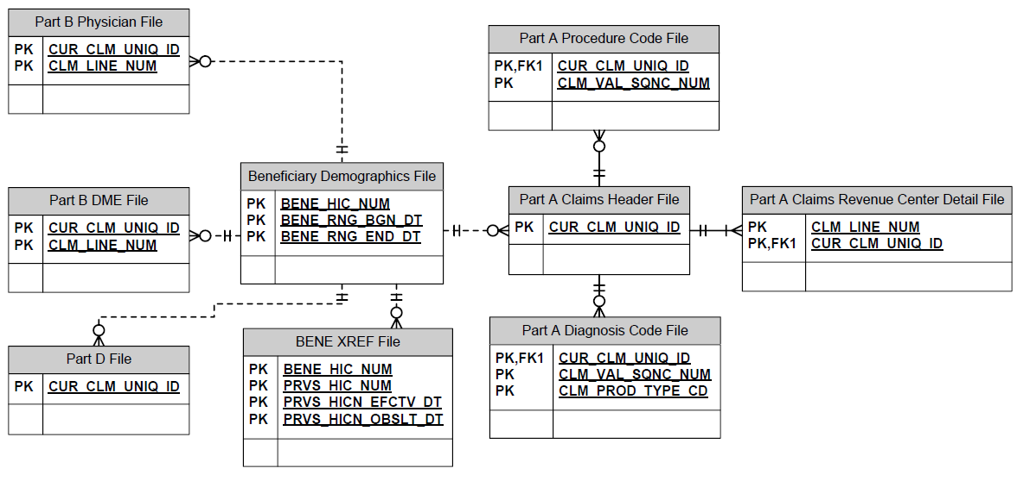
Data – CMS Claims Data Files

Slide 3
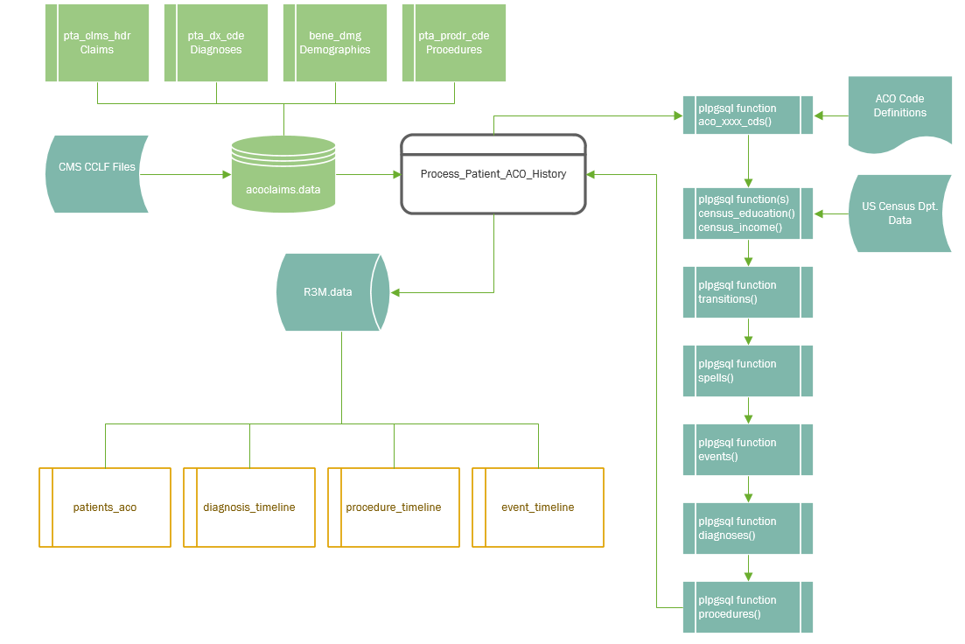
ACO Data Integration

Slide 4
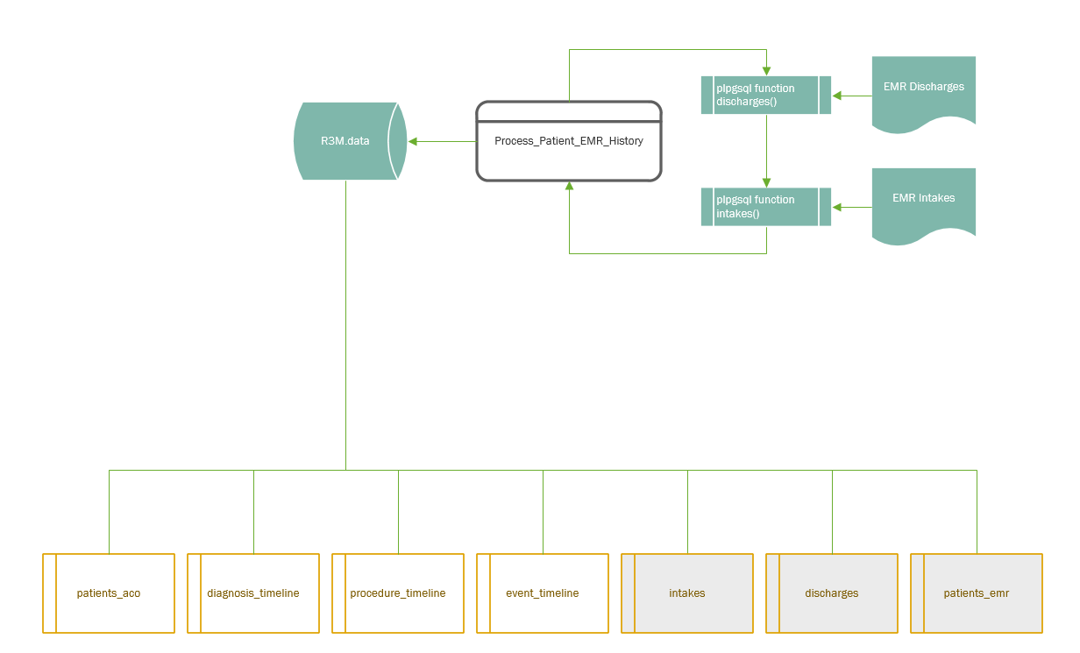
EMR Data Integration

Slide 5
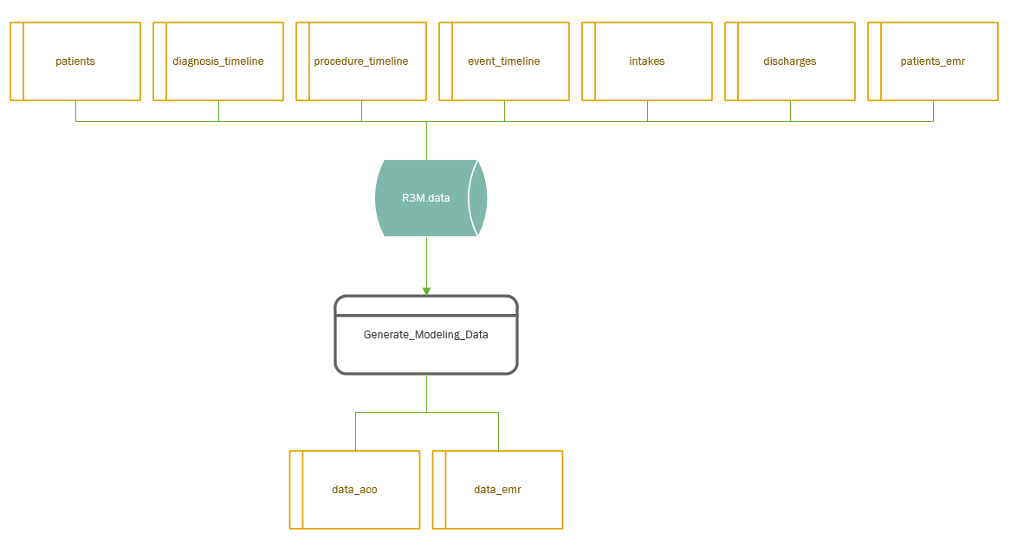
Generating Modeling Data

Slide 6
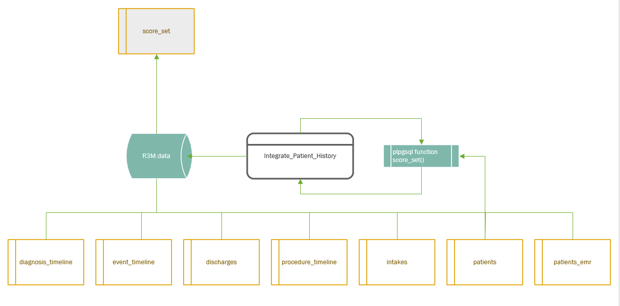
Daily Process – Data Integration

Slide 7
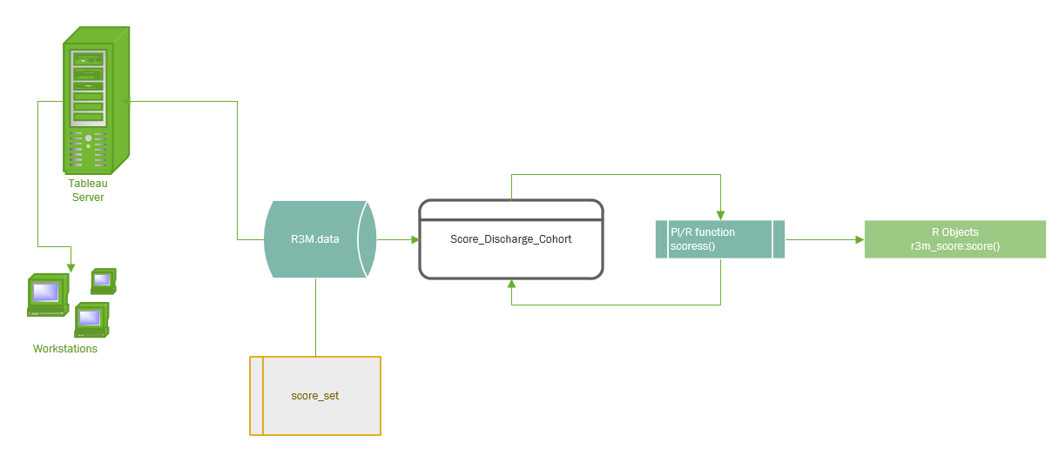
Daily Process – Scoring

Slide 8
EMR Only Model
Prior history limited to:
Number of previous ED visits (at UVA)
Number of previous inpatient stays (at UVA)
No diagnosis or discharge within first 5 days
Demographics limited to:
Age
Gender
Socioeconomic data imputed by city / zip code

Slide 9
Variable Selection

Slide 10
Silent Test Error Rate

Slide 11
Variable Selection

Slide 12
Silent Test Error Rate

Slide 13
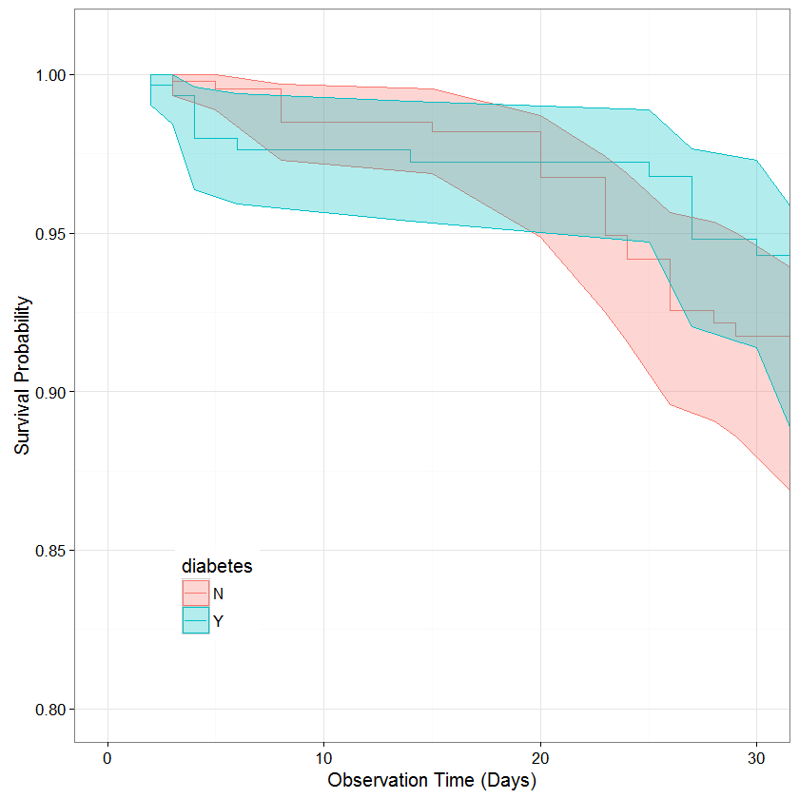
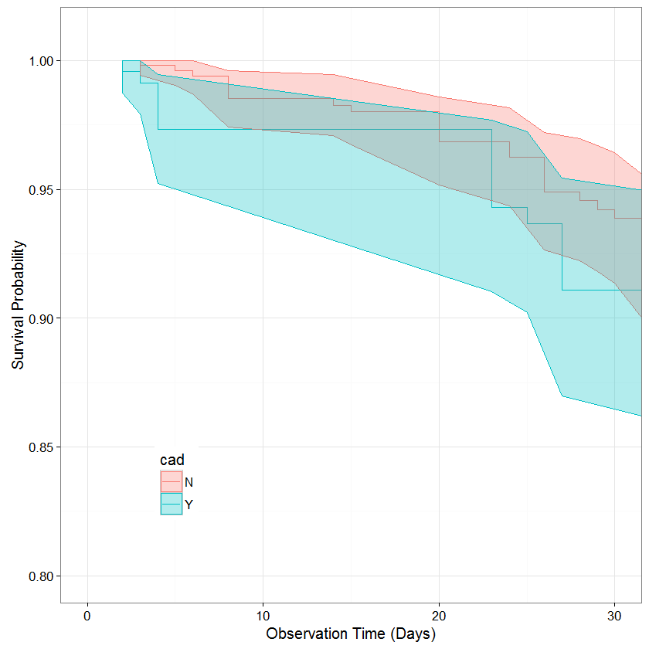
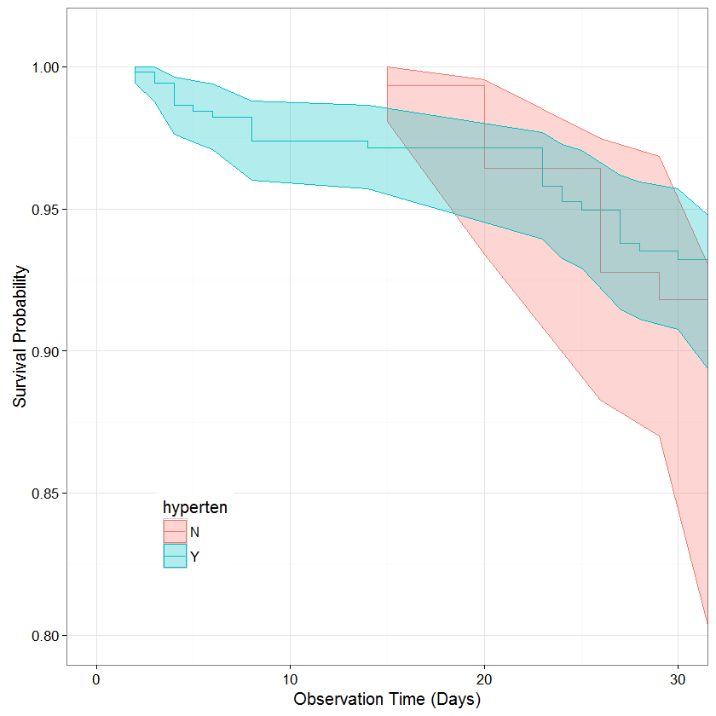
Separability

